Slide 1
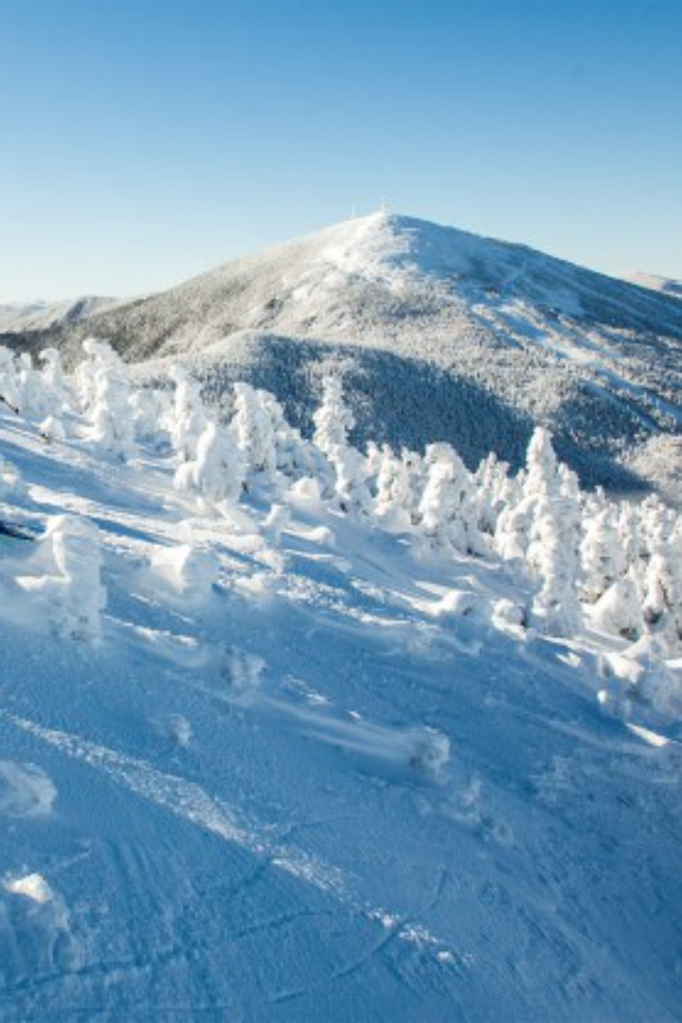

Refining Pricing and Optimizing Facilities at Big Mountain Resort
by Hayat Rakab

Slide 2

Problem Identification: The Challenge at Big Mountain Resort
Premium Pricing Challenge: Big Mountain Resort, despite its premium pricing approach, suspects undercapitalization on its facilities. A reliance solely on market average pricing may hinder investment strategies.
Operational Cost Concerns: The resort recently added a chairlift, escalating operating costs by $1,540,000. Finding a balance between facility enhancement and profitability is imperative.
Value Proposition & Data-Driven Strategy: The goal is to determine a more accurate ticket pricing and consider potential facility changes.

Slide 3

Data Overview & Challenges
Initial dataset of 330 rows with ski resort details
Addressed issues like missing values, data inconsistencies, and anomalies
Refined dataset: 277 rows, 25 columns.

Slide 4

Recommendation and Key Findings: Proposed Ticket Pricing
Model suggests a ticket price of $95.87
Current price: $81.00
Recommended increase: $14.87
Importance of phased implementation for monitoring customer response.

Slide 5

Modeling Results and Analysis: Scenario Analysis - Part I
Examined the impact of closing down up to 10 least used runs.
Significant drops were observed when closing 3 or more runs.
Suggested adding a run with a new chairlift to increase the vertical drop by 150 feet.
Potential revenue increase: $3,474,638/season

Slide 6

Modeling Results and Analysis: Scenario Analysis - Part II
Analyzed the impact of adding 2 acres of snow making cover.
Result: No significant difference observed.

Slide 7
Modeling Results and Analysis: Scenario Analysis - Part III
Considered increasing the longest run by 0.2 mile with additional snow-making coverage.
Result: No significant difference observed.

